Slide 1
Chapter 14: Keeping Windows Server 2025 Up to Date
Azure Arc, Azure Update Manager, Hotpatch, and modern patch governance

Slide 2
Learning Objectives
01 Explain why modern Windows Server patch management uses Azure Update Manager instead of WSUS alone
02 Connect Windows Server 2025 to Azure via Azure Arc and enable centralized, cloud-based patching
03 Schedule and deploy updates using maintenance windows, patch rings, and compliance reporting
04 Reduce reboot impact using Hotpatch and control which patches deploy using include/exclude filters
Windows Server 2025 | Chapter 14 | Keeping Windows Server Up to Date
02

Slide 3
Chapter Topics
01 14.1 Why patch management has changed - and what replaces the old model
02 14.2 Azure Arc and Azure Update Manager: architecture and onboarding
03 14.3 Scheduling, patch rings, compliance, and update deployment
04 14.4 Hotpatch, patch exclusions, WSUS/GPO/WUfB, and best practices
Windows Server 2025 | Chapter 14 | Keeping Windows Server Up to Date
03

Slide 4
Why Patch Management Has Changed
The traditional WSUS and Group Policy model was designed for fully on-premises environments. Hybrid and cloud-connected estates have changed the requirements for patch governance.
Servers now span on-premises, hosted, and cloud environments - WSUS only sees what it manages
Security and compliance teams need a single dashboard covering all machines
Patch Tuesday cadence is unchanged, but deployment must be coordinated across environments
Modern tooling uses Azure identity, RBAC, and Policy instead of Active Directory GPOs
Reboot impact on 24x7 workloads drives demand for innovations like Hotpatch
Azure Update Manager replaces the need for separate WSUS, OMS, and Automation accounts
Windows Server 2025 | Chapter 14 | Keeping Windows Server Up to Date
04

Slide 5
Traditional Windows Server Update Methods
Before Azure Update Manager, administrators chose from several tools depending on environment size and management model.
Windows Update: automatic or manual, per-server, no central control
WSUS (Windows Server Update Services): on-premises approval and distribution, GPO-controlled
Windows Update for Business (WUfB): deferral and ring-based via Group Policy or Intune
Microsoft Endpoint Config Manager (MECM/SCCM): enterprise-scale, requires significant infrastructure
Limitations: WSUS requires patching its own infrastructure; no unified view across sites
None of these provide visibility into non-domain or cloud-hosted servers out of the box
Windows Server 2025 | Chapter 14 | Keeping Windows Server Up to Date
05

Slide 6
What Azure Update Manager Does
Azure Update Manager (AUM) is a native Azure service for assessing and deploying OS updates across Azure VMs and Azure Arc-enabled servers - with no dependency on Log Analytics or Azure Automation.
Performs update assessment: shows missing patches per machine, filtered by classification
Deploys updates on demand (one-time) or on a defined schedule (maintenance configuration)
Centralized compliance dashboard - all machines in one subscription or across subscriptions
Supports Windows (KB-based) and Linux (package-based) updates
Include or exclude specific KB IDs in every deployment run
Integrates Hotpatch for reboot-free security updates on Windows Server 2025
Uses Azure RBAC - grant update operators access at resource group or subscription level
Windows Server 2025 | Chapter 14 | Keeping Windows Server Up to Date
07

Slide 7
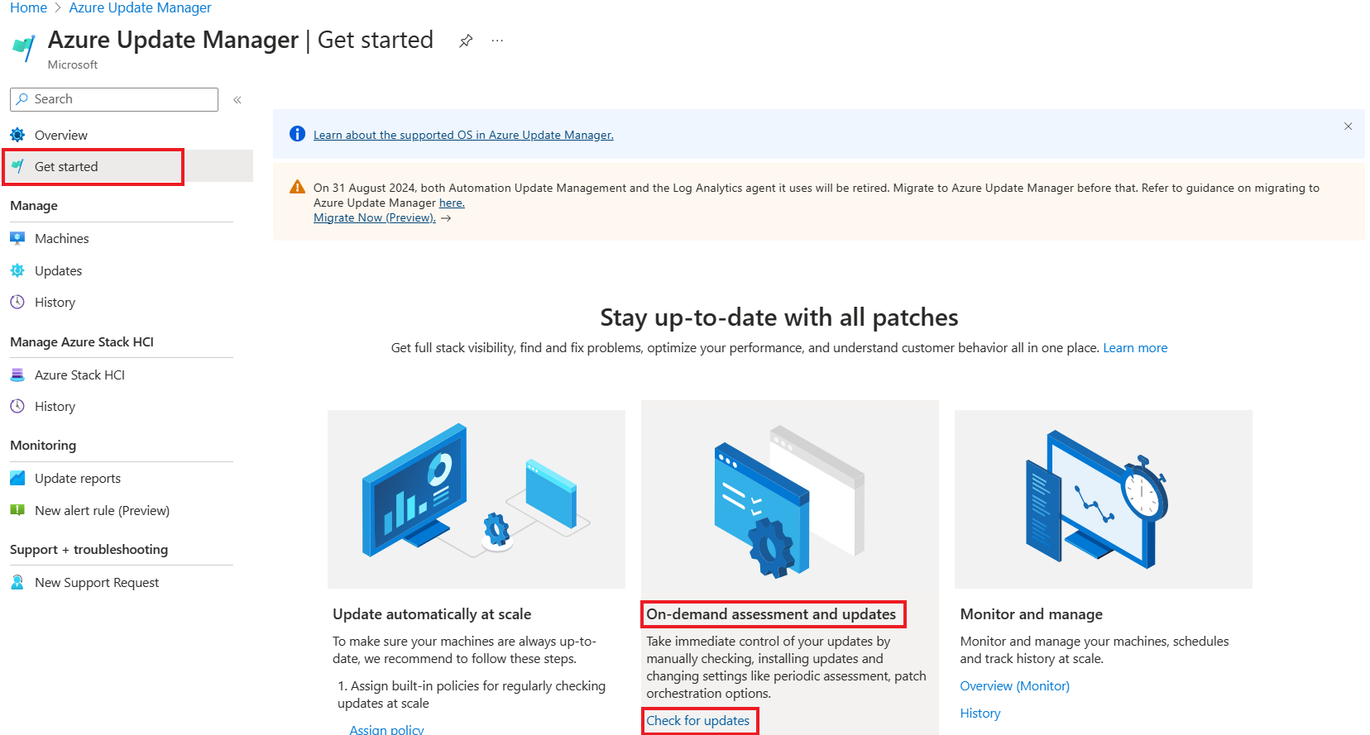

Slide 8
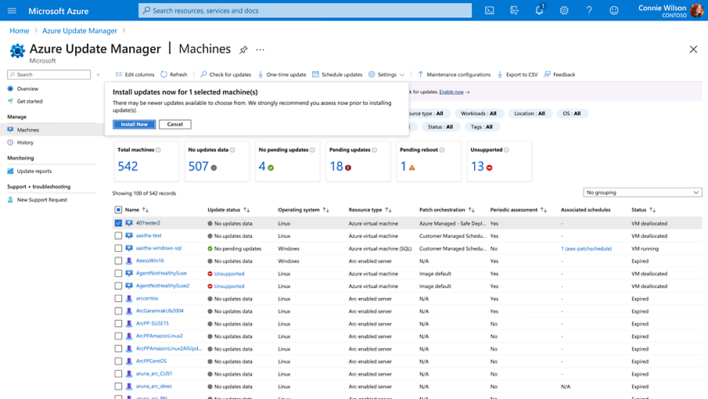

Slide 9
Azure Update Manager: Architecture and Data Flow
Server has the Connected Machine agent (azcmagent) installed - communicates outbound to Azure on port 443
Server registers as an Azure Arc-enabled resource with subscription, resource group, location, and tags
Azure Update Manager queries the agent to collect Windows Update assessment data (missing patches, severity)
Compliance results are written to Azure - visible in the Update Manager dashboard and queryable via Resource Graph
Maintenance configuration fires on schedule: AUM sends the patch list to the agent, which installs updates locally
Pre-event (Event Grid): invoke an Automation runbook to snapshot VMs or stop services before patching begins
Post-event (Event Grid): restart services, send notification, or update a CMDB record after patching completes
Update history and reboot status are reported back to Azure - stored for audit and compliance review
Windows Server 2025 | Chapter 14 | Keeping Windows Server Up to Date
08

Slide 10
Admin Decision Matrix
Choose the management tool based on visibility, control, connectivity, and existing operational model.
Best fit
Tool
Limit
AUM
Unified Azure/Arc compliance and scheduling
Needs Azure resource governance
WSUS
Disconnected or local approval model
Limited hybrid visibility
GPO/WUfB
Client policy, deferral, restart control
Not a compliance dashboard
MECM
Large enterprise endpoint estates
More infrastructure
3rd party
Mixed vendor operations
Validate Windows Server support
Windows Server 2025 | Chapter 14
Windows Server 2025 | Chapter 14 | Keeping Windows Server Up to Date
10

Slide 11
Azure Update Manager: Architecture Overview
AUM uses the Connected Machine agent as its communication channel. The server remains where it is; assessment, deployment orchestration, and reporting flow through Azure Arc.
Windows Server
On-premises or cloud
azcmagent
Connected Machine agent
Azure Arc resource
Portal representation
Azure Update Manager
Assess, deploy, report
Compliance + history
Dashboard and audit
Port 443 outbound; no separate Log Analytics or Automation dependency for AUM.
Understand how the agent, Arc, and AUM fit together before configuring anything
Key Takeaway
Administrative Focus
Windows Server 2025 | Chapter 14 | Keeping Windows Server Up to Date
11

Slide 12
Update Assessment and Compliance
The compliance view answers which machines are missing which updates before you deploy anything.
Assess
Classify
Deploy
Export to CSV or query through Azure Resource Graph.
Automatic periodic assessment every 24 hours or manual Assess now
States: Compliant, Non-compliant, Unknown
Administrative Focus
Use the compliance dashboard to identify missing patches before deploying
Windows Server 2025 | Chapter 14 | Keeping Windows Server Up to Date
14

Slide 13
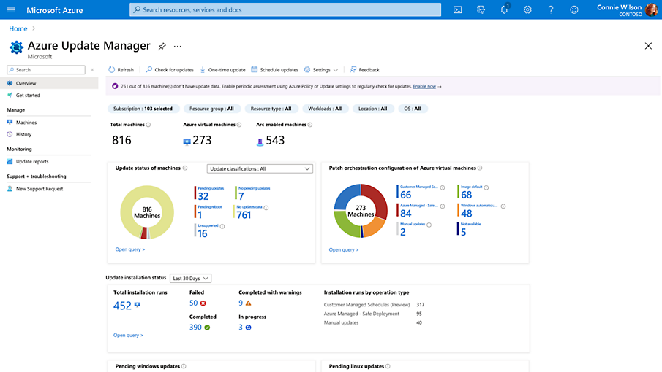

Slide 14
Scheduling Updates with Maintenance Windows
What a maintenance window controls
Example: Production Maintenance Configuration
•
When the recurring update deployment starts and how often it repeats
Scope
•
Which Azure VMs or Arc-enabled servers are in scope
Guest OS updates for Arc-enabled servers
Schedule
•
Which update classifications or KB packages are included or excluded
Monthly, following Saturday, 02:00
Window
•
How Azure Update Manager should handle reboots during the run
3-4 hours for production patching
Reboot
If required; never only after policy review
Design guidance
Assignment
Dynamic scope: Environment=Prod
•
Use separate schedules for Dev, Test, Prod, and domain controllers
•
Leave enough time for install and reboot cutoffs; rerun if the window is exceeded
Portal path
Azure Update Manager > Scheduled updates > Create maintenance configuration
•
Check Windows restart policy because local settings can override expectations
One schedule should express one operational intent: ring, time window, update selection, and reboot policy.
Windows Server 2025 | Chapter 14 | Keeping Windows Server Up to Date
16

Slide 15
Hotpatch for Windows Server 2025
Azure Arc-enabled Windows Server 2025 Standard and Datacenter machines can use Hotpatch when the feature is enabled through Azure Arc and managed with AUM.
Hotpatch enablement
OS: Windows Server 2025
Edition: Standard/Datacenter
Goal: fewer planned reboots without skipping security updates.
State: Arc connected
Manage through AUM
Baseline months still require restart
Enable Hotpatch on eligible Windows Server 2025 Arc-enabled machines to reduce reboot frequency
Windows Server 2025 | Chapter 14 | Keeping Windows Server Up to Date
20

Slide 16
Hotpatch Cadence and Baselines
Jan
Feb
Mar
Apr
May
Jun
Jul
Aug
Sep
Oct
Nov
Dec
Baseline + reboot
Hotpatch
Hotpatch
Baseline + reboot
Hotpatch
Hotpatch
Baseline + reboot
Hotpatch
Hotpatch
Baseline + reboot
Hotpatch
Hotpatch
Typical planned year: four baseline months and eight hotpatch months. Unplanned baselines can occur for updates that cannot be delivered as a hotpatch.
Hotpatch works from a current cumulative update baseline, then applies security hotpatches in the next two months.
Windows Server 2025 | Chapter 14
Windows Server 2025 | Chapter 14 | Keeping Windows Server Up to Date
21

Slide 17
Hotpatch Boundaries
Hotpatch reduces restart pressure, but administrators still plan for baselines and update categories outside the Hotpatch program.
Covered by Hotpatch
Still needs normal planning
- Windows security updates
- Faster install path
- No restart for hotpatch months
- Baseline cumulative updates
- Nonsecurity Windows updates
- .NET updates
- Drivers and firmware
Hotpatch reduces restart frequency. It does not remove maintenance windows, baseline planning, or nonsecurity update governance.
Windows Server 2025 | Chapter 14
Windows Server 2025 | Chapter 14 | Keeping Windows Server Up to Date
22

Slide 18
Blocking, Excluding, or Deferring a Specific Patch
AUM supports KB-level include and exclude controls for one-time deployments and scheduled update selection.
Update selection
Include: Critical, Security
Exclude KB ID/package
Remove exclusions once the risk is resolved.
Example: 5067077
Review + create
Document owner, reason, and expiry for every exclusion.
Windows Server 2025 | Chapter 14 | Keeping Windows Server Up to Date
23

Slide 19
Knowledge Check
1
A new Windows Server 2025 is installed on-premises. What is the first step to manage its patches from Azure Update Manager?
2
A patch causes a production application to crash. How would you prevent that specific KB from deploying to production servers on the next scheduled run?
3
You have Dev, Test, and Prod server groups. How would you use Azure tags and maintenance configurations to stagger patching across these rings?
4
Windows Server 2025 is Arc-enabled and you enable Hotpatch. How many planned reboots should you expect for OS patching in a typical year?
Windows Server 2025 | Chapter 14 | Keeping Windows Server Up to Date
25

Slide 20
PRACTICE LAB
Lab 1401
Azure Arc Onboarding and Azure Update Manager
In this lab, you will connect LON-SRV1 to Azure Arc using the Arc Setup wizard, explore the Azure Update Manager compliance view, create a maintenance configuration schedule, and perform an on-demand patch assessment. You will also enable Hotpatch and verify the update history.
Windows Server 2025 | Chapter 14 | Keeping Windows Server Up to Date
26

